Slide 1

Ho chi
COVID-19 AWARENESS ENSE885as project
200436599

Slide 2


Sustainable Development goals

Slide 3
Project target
Updating official news for Users
Provide users the basic background (Symptom of Covid-19, the precautions for Covid-19 or Coronavirus Cases statistic in the area they are living) through the Quizz game
Updating the statistic related to user’s area

Slide 4
CONtent
The main feature review
Project Commercial
Detailed demo of each function
Reflection
Future work

Slide 5
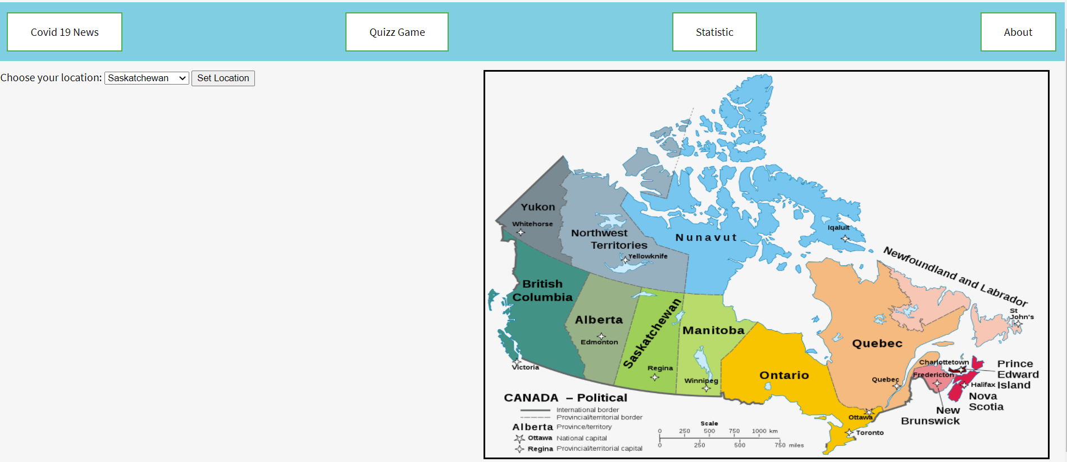
The main features
Homepage

Slide 6
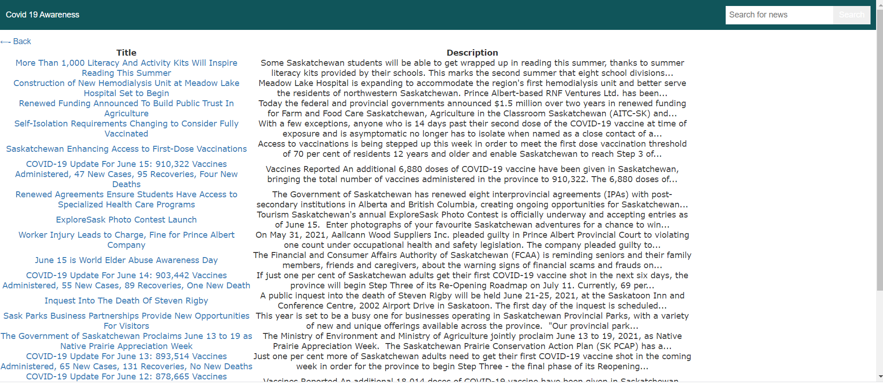
The main features
News page

Slide 7
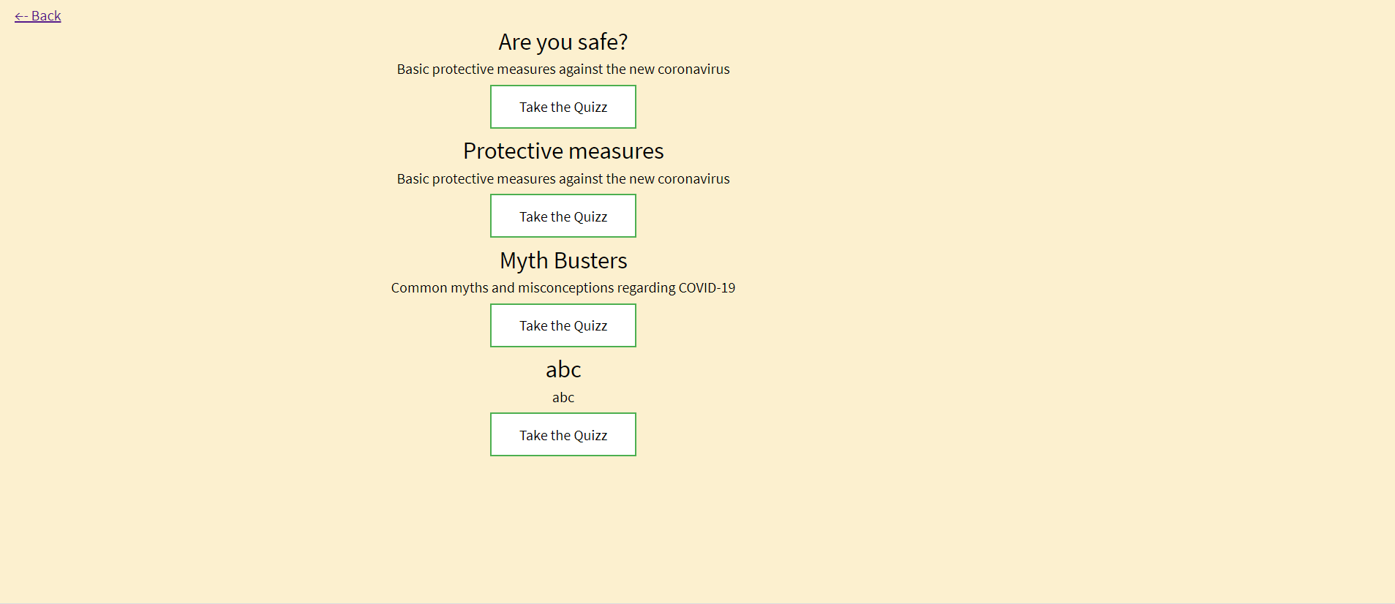
The main features
Quiz Game page

Slide 8
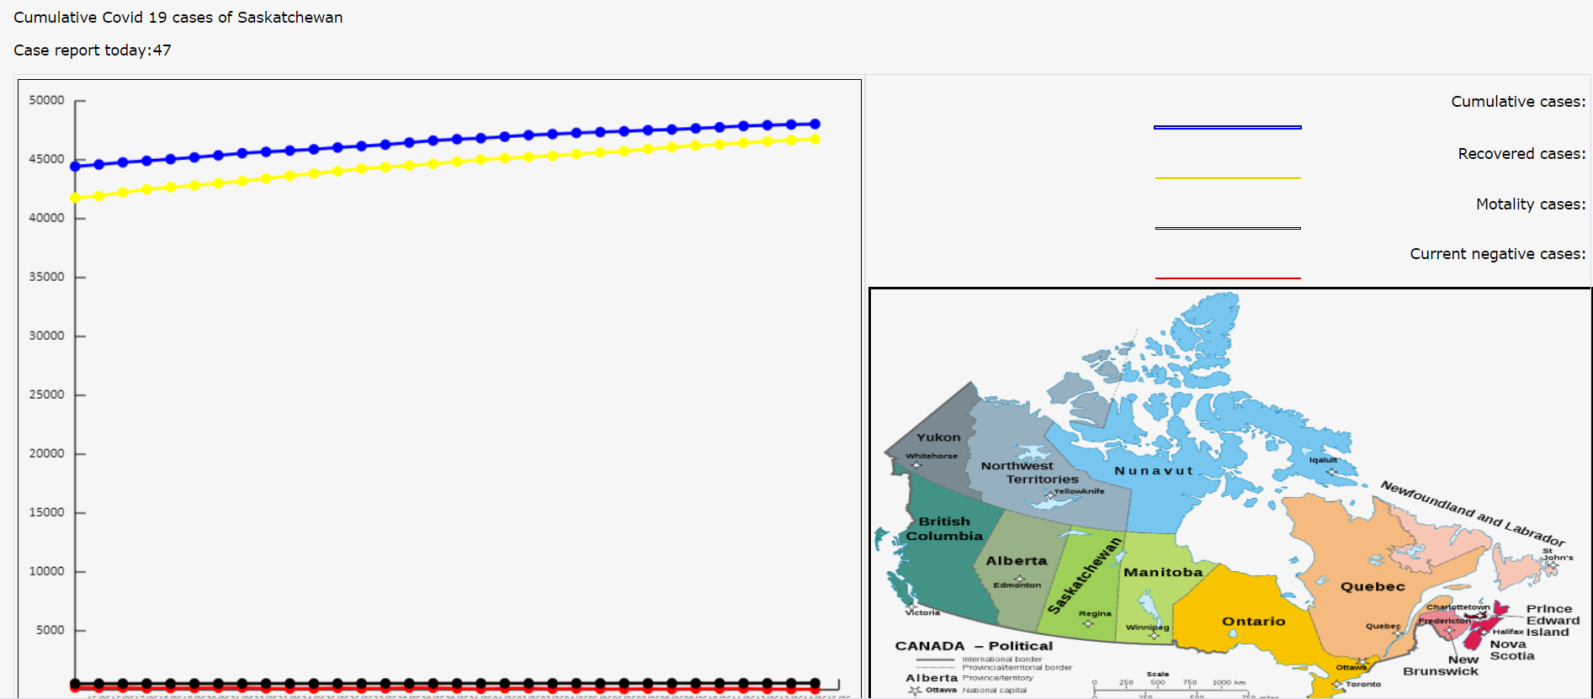
The main features
Covid-19 statistic page

Slide 9
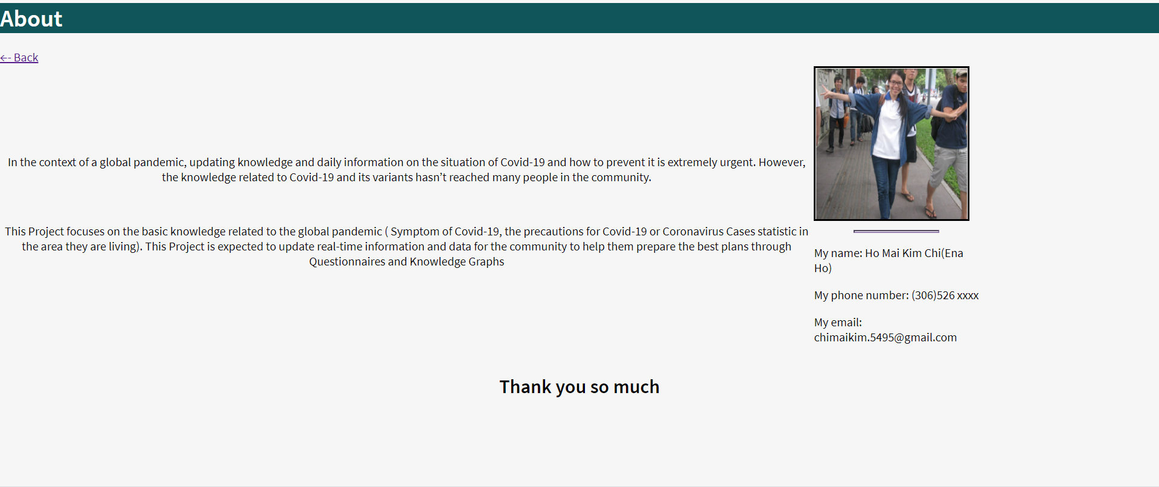
The main features
About page

Slide 10

Project commercial

Slide 11
detailed demo of each function

Slide 12
Reflection
Summarize how you felt about this project (likes/dislikes), from your experiences with the technology stack selected, translating prototypes into real solutions, and the evolution of your Minimum Viable Products (MVPs)
Summarize what went well during the project
Summarize what not went well during the project
Summarize software design activities and findings. Ensure you discuss how you either linked or envision links to design ideas back to topics discussed in class
What would you do the same on future projects?
What would you do differently on future projects?
Notes:
Learn a new programing language. JavaScript is one of the most popular language right know.
How to manage time to build a project alone
Using dataset by json and create the questionnaire that is almost the same goal I set out earlier
The expectation is create chatbox to support for users
Create an initial low prototype design and Architectural diagram then build HTML pages on that then I finding to build backend. Try to create a friendly interface for user and aim to provide Covid 19 information as much as I can
Design architecture and front-end

Slide 13
Future work
Create ChatBox
Improve front-end more friendly and beautiful
Add more type of graph

Slide 14

Thank you
Ho chi

